Slide 1


Team Members:
GUO Zhenhui 55469991
LIN Fanggeng 55458792
SUN Yuxi 55422550
XU Jiahe 55395280
ZHOU Zixuan 55366688
ZHU Jiaxun 55419023
2019.4.12

Slide 2
CONTENT
1
Background
2
Market Research
3
Main Functions
4
Technical Issue

Slide 3
1
Background
Student No.: 55458792
LIN Fanggeng

Slide 4


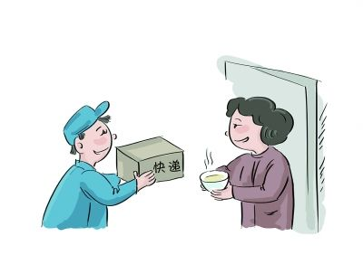
Students' one-stop life learning platform
Express delivery and collection
Second-hand transactions
Course discussion

Slide 5
Main Features
One-stop
Satisfy the three most urgent requirement of students
Centrality
Gather the students with same needs in the platform
Safety
School email and school ID card real-name authentication

Slide 6


Orientation
CURRENT
Target users: Students in CityU
Realization: for free
PROSPECTIVE
Target user: All university students in Hong Kong
Realization: Advertisement+service charge

Slide 7
2
Market Research
Student No: 55419023
Student Name: ZHU Jiaxun
Notes:
What’s next is the market research

Slide 8


Type of competing product
香不香港
Professional app
focus on this function
.
WeChat
Communication app
with this function
.
Notes:
There are two main applications in the Google Play market today. One is the professional app focusing on the express delivery service. And the other one is communication app where you can look for the business partner. Here I select two typical cases to explain them in detail.

Slide 9

1.香不香港

Slide 10
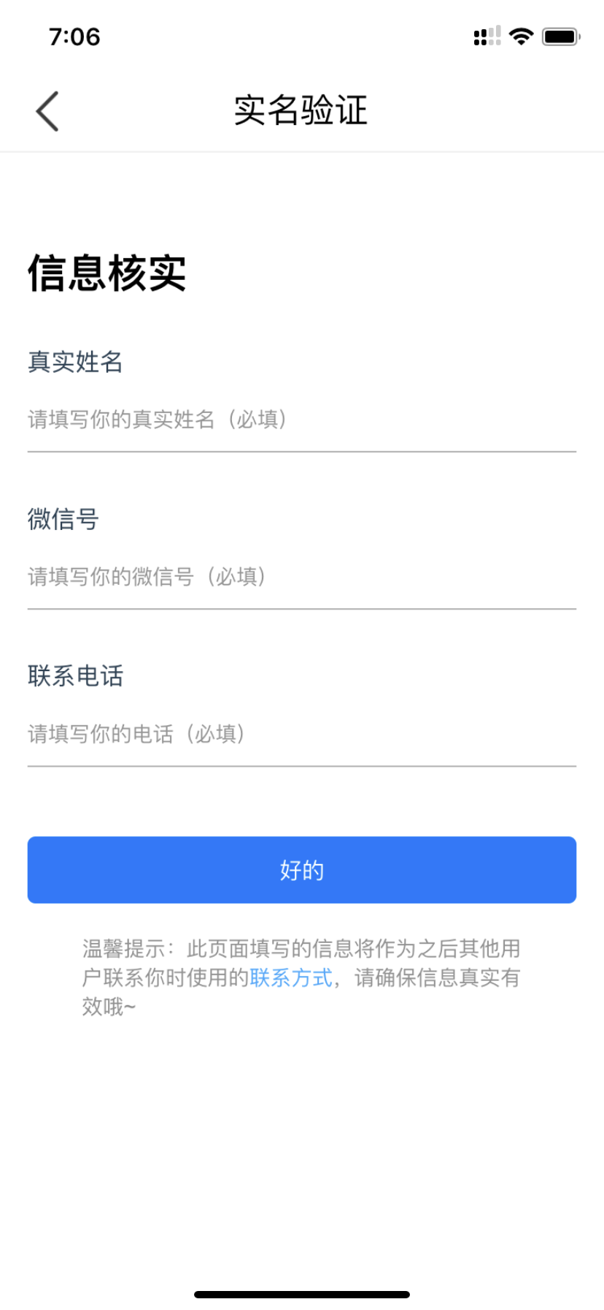
1.1 Privacy
If you want to experience the service of this app, the first step is to register an account with your real name, wechat number and your phone number.
Notes:
The first issue of this app is the privacy or you can say security problem. When you get into this app, you are required to register an account before you enjoy any services in it. And here is the screenshot of their registration page. You are asked to fill the blanks with your real name, wechat number, and phone number. Sounds really secure, right? But, unfortunately I was a lucky guy. Cuz I was authenticated with a dummy wechat account and phone number successfully.
In our app, we don’t ask you for this kind information. You need to upload your student card picture. Well, perhaps you will think what if uploading others’ student card. We also need you to leave a cityu email address which is used to receive our authentication email. This can ensure that you are indeed the cityu student.

Slide 11
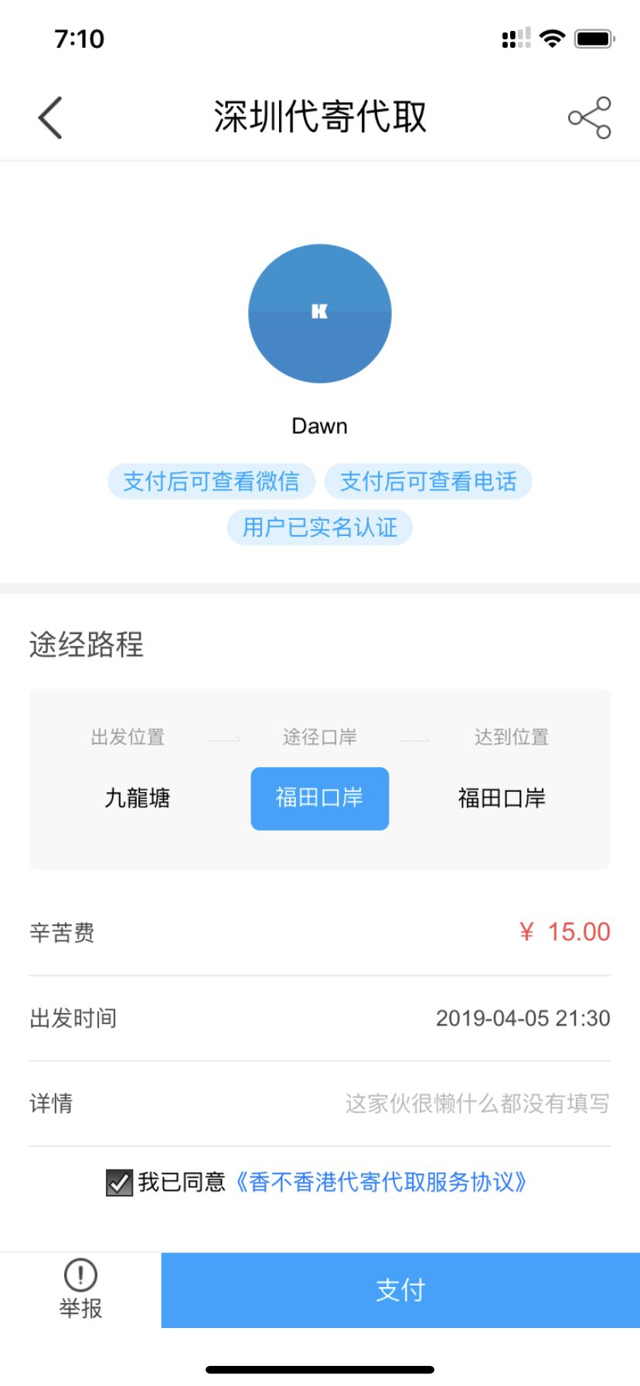
1.2 The right of choice
When you click on one of the published service, the first thing you need to do is paying.
Notes:
The second problem is relative to the user experience – the right of choice. After registration, you can access to the express delivery service. But you can’t talk to anyone, can’t have a look at the detail of the business unless you pay for it first. I think this is really annoying on the user experience where users are forced to pay before diving into it.
So, instead of disgusting users, we have better designs which means you can negotiate with others before making the deal. And we don’t provide online transactions for the security reason. It’s better to make a face-to-face transaction.

Slide 12
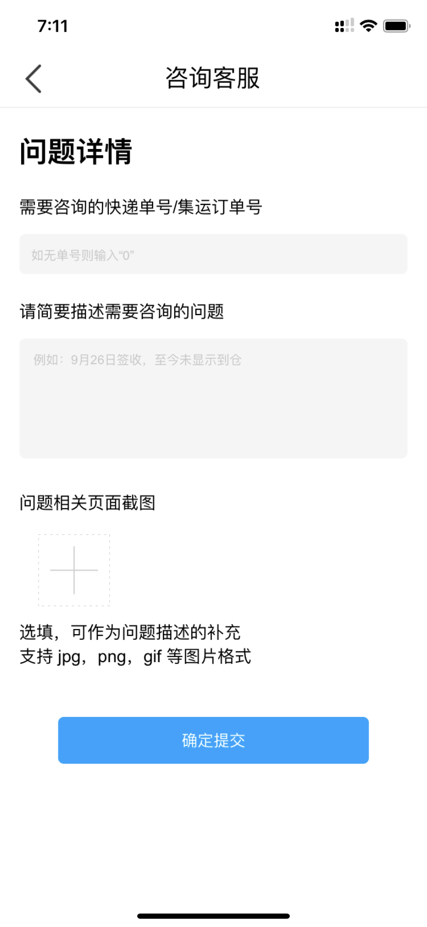
1.3 The complaint service
In this app, there is no complaint entrance for this function which means troubles come after the incidents.
Notes:
The last issue is they don’t have a complaint entry for this service. They only provide complaint service for other functions in their app which means you might have no idea when an incident happens.
In our app, we use a compression algorithm to transfer all your chatting history into a QR code and the system will automatically upload the QR code to the cloud server, i.e., you can extract all your chatting history as the proof when there is a conflict happening. And my partner will talk about it later.

Slide 13
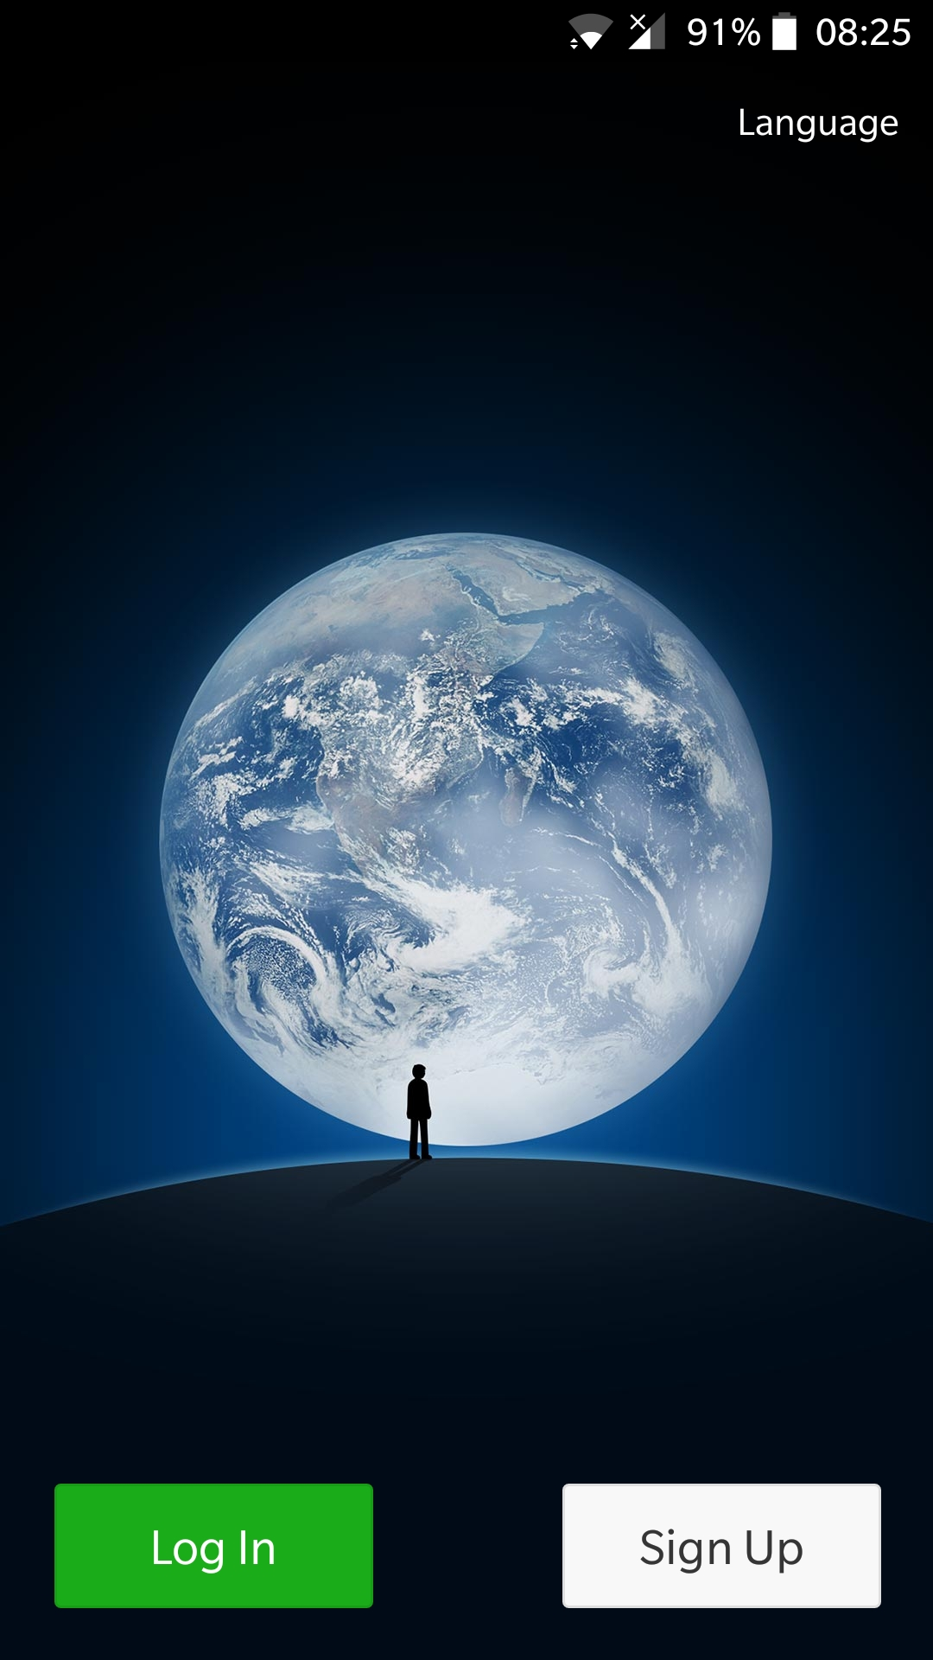
2. WeChat

Slide 14
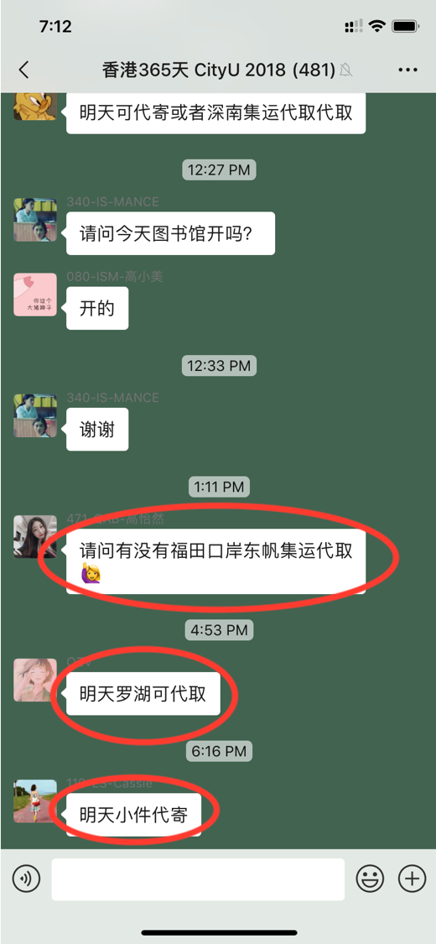
2.1 Less is more
Steps of getting this service in wechat:
1. Search for the service
2. Send the friend request to the appropriate people
3. Discuss the details of your business
4. if(he == the correct guy){
make the deal;
delete his wechat account;
}else{
keep searching for the correct guy;
}
Notes:
First of all, let’s have a look on this screenshot. There are three guys proposing their service information. Most mainland students would like to use the wechat group to search for the express delivery service. But you have to encounter two barriers when you are using the wechat.
The first one is the procedures are too complicated. It doesn’t follow the concept – less is more. If you wanna find a correct guy to do the business, you are suppose to do.......

Slide 15
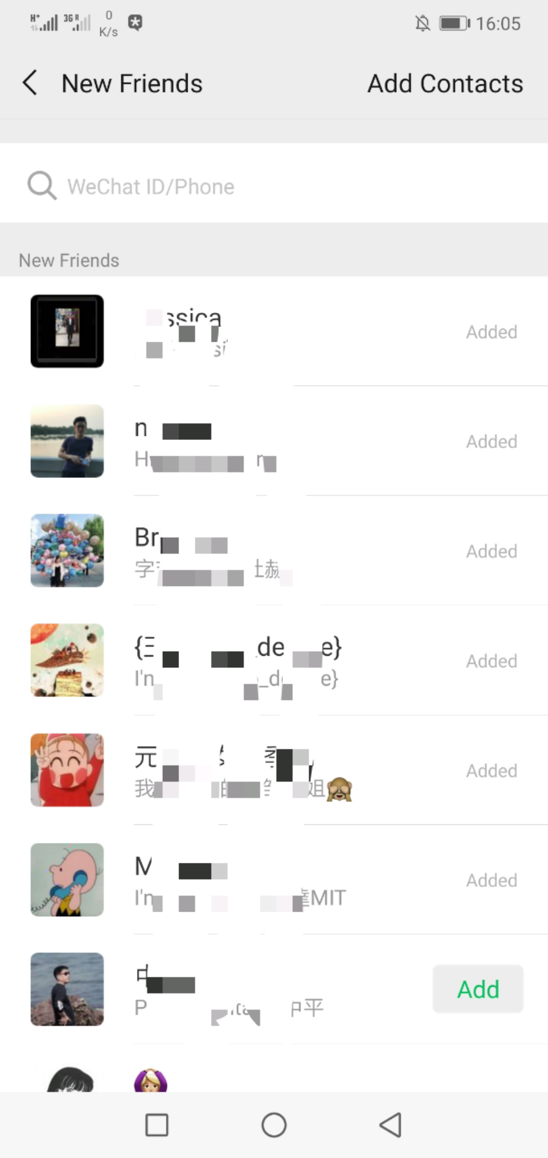
2.2 Endless friend requests
You have no idea that whether or not the service information is still valid unless you send him a friend request.
Notes:
The wechat provides the message recall function for users. But the time limit is two minutes which means your message will stay there forever after two minutes. And this will lead to a disaster shown in the picture. You will receive enormous friend requests although you have already finished your business.
So, in order to avoid this situation, we require users to set up the expiry time for their business. When the time is up, your service information will disappear automatically.
The next part my partner will introduce the functions of our application.

Slide 16
3
Main functions
GUO Zhenhui 55469991
SUN Yuxi 55422550
XU Jiahe 55395280

Slide 17
Part 1：Register
1
Submit student information
2
Get init passwords and update account information

Slide 18
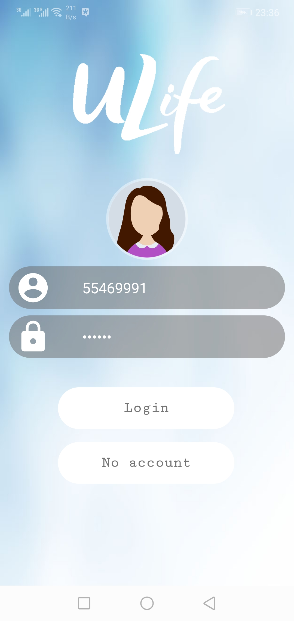
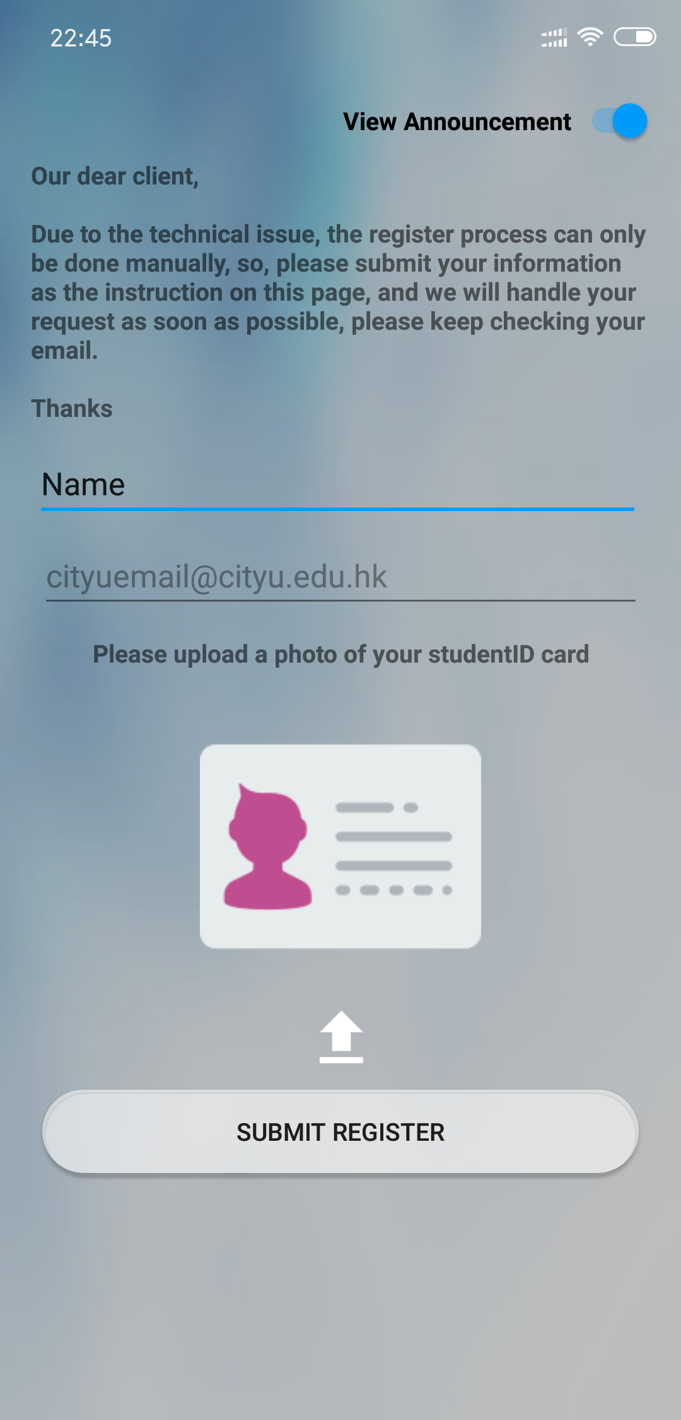
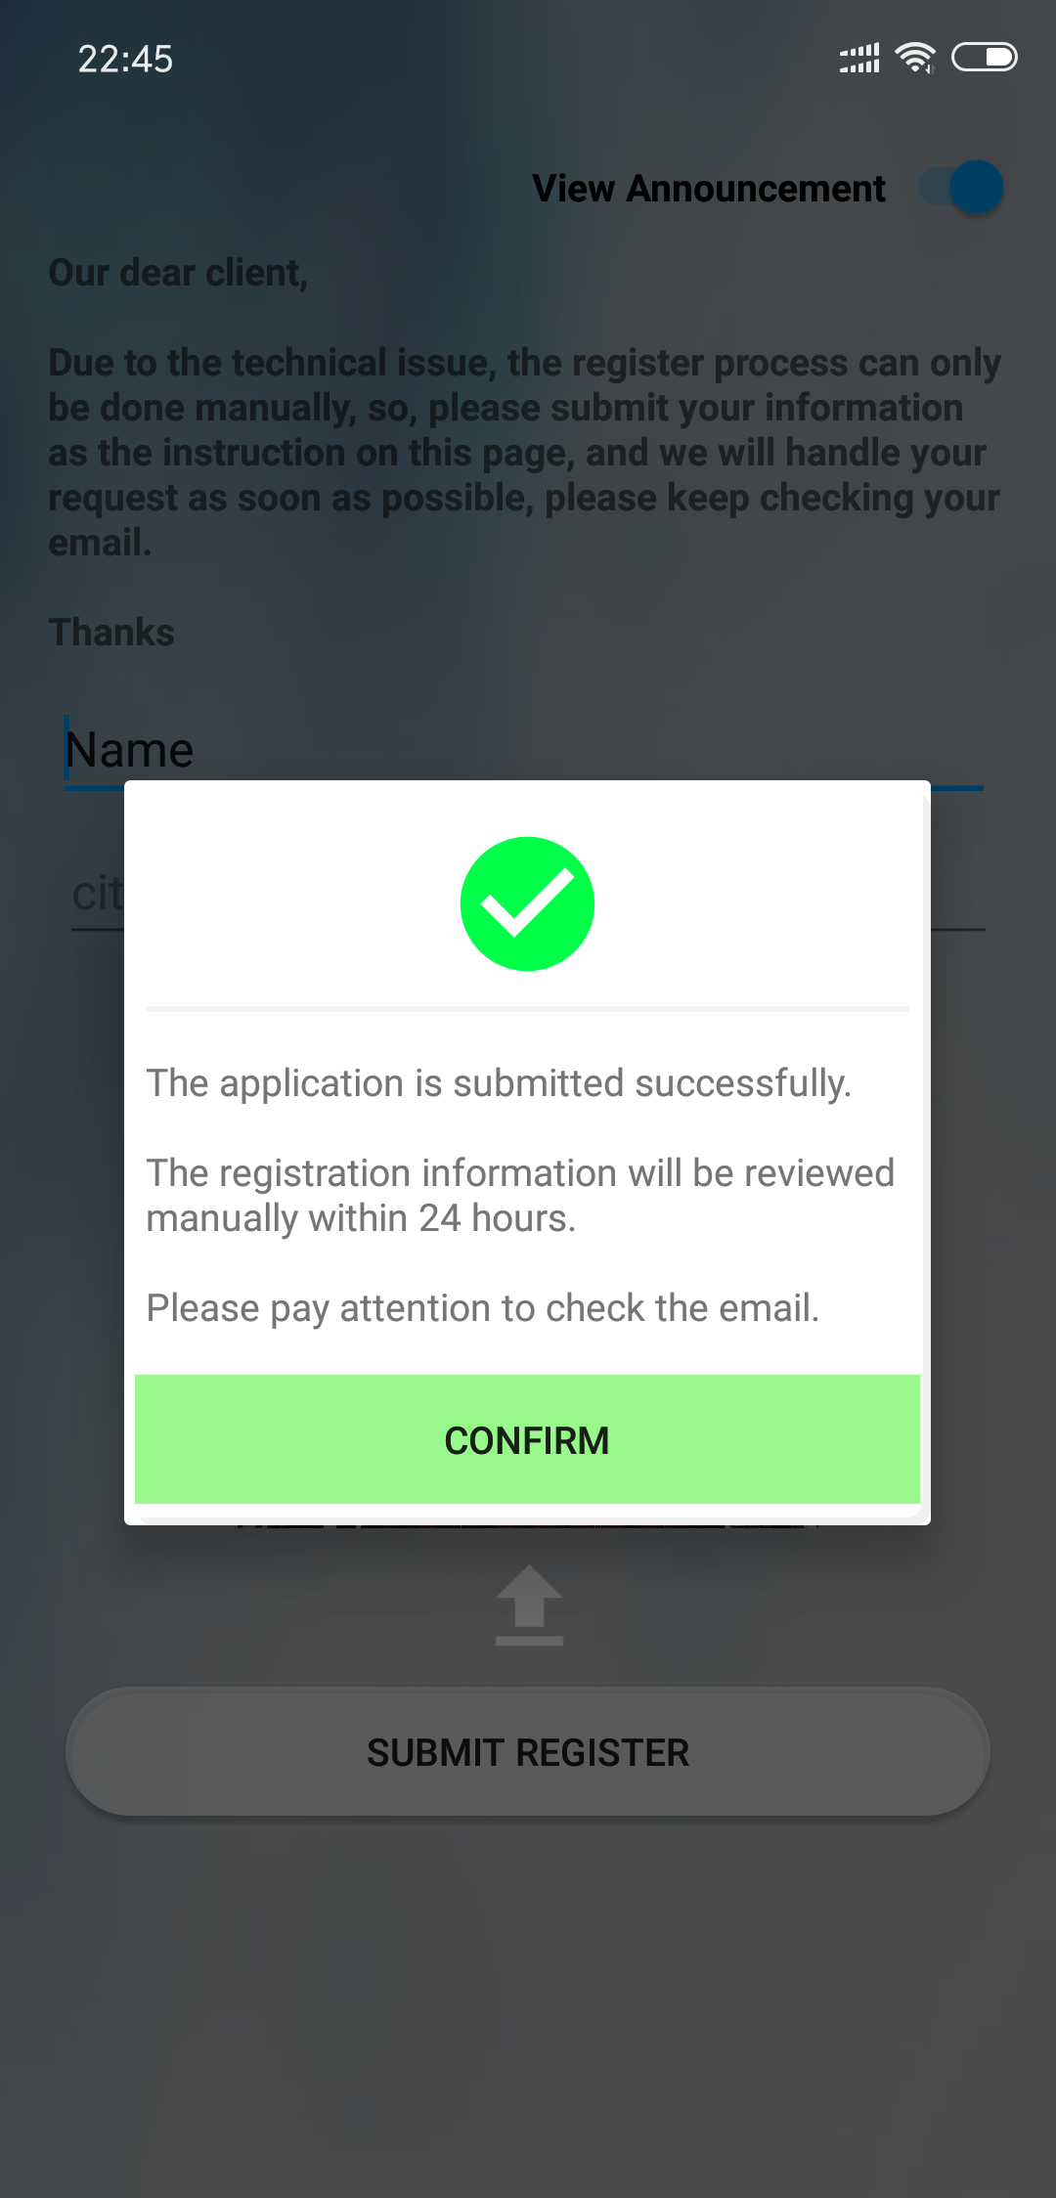
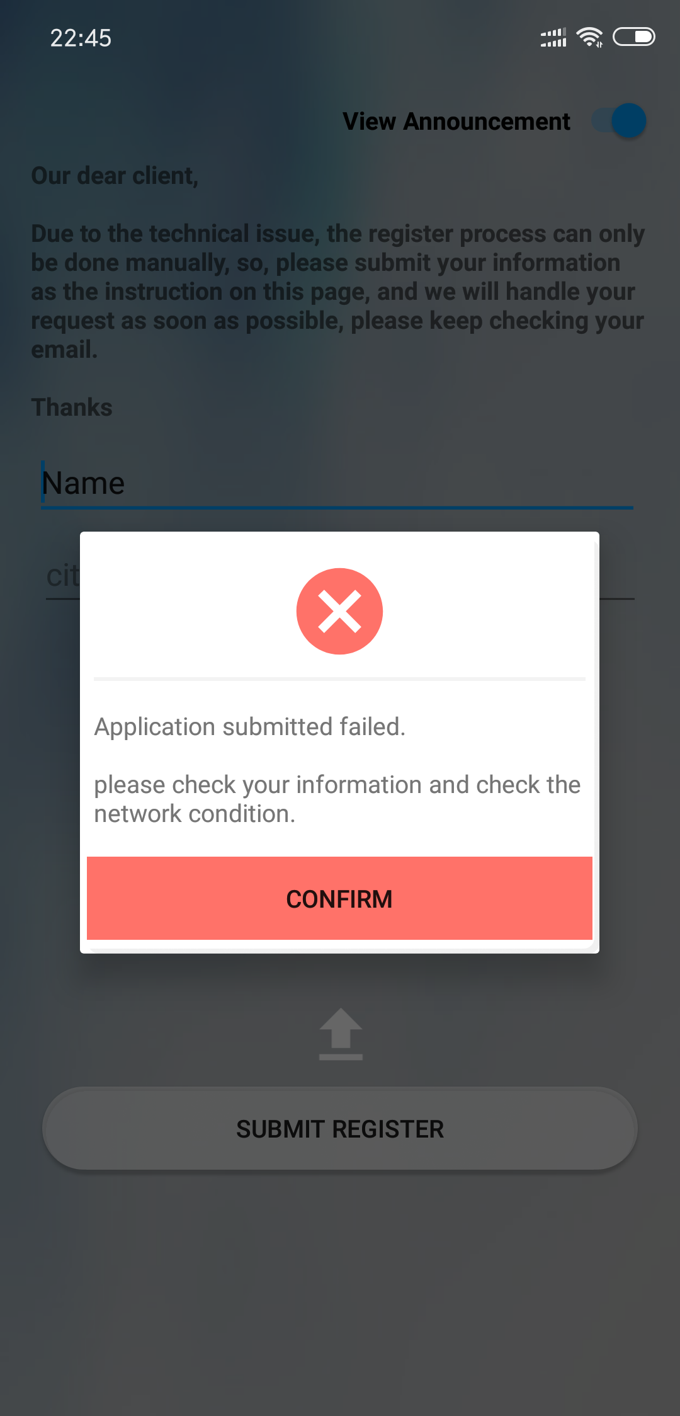
Submit student information

Slide 19
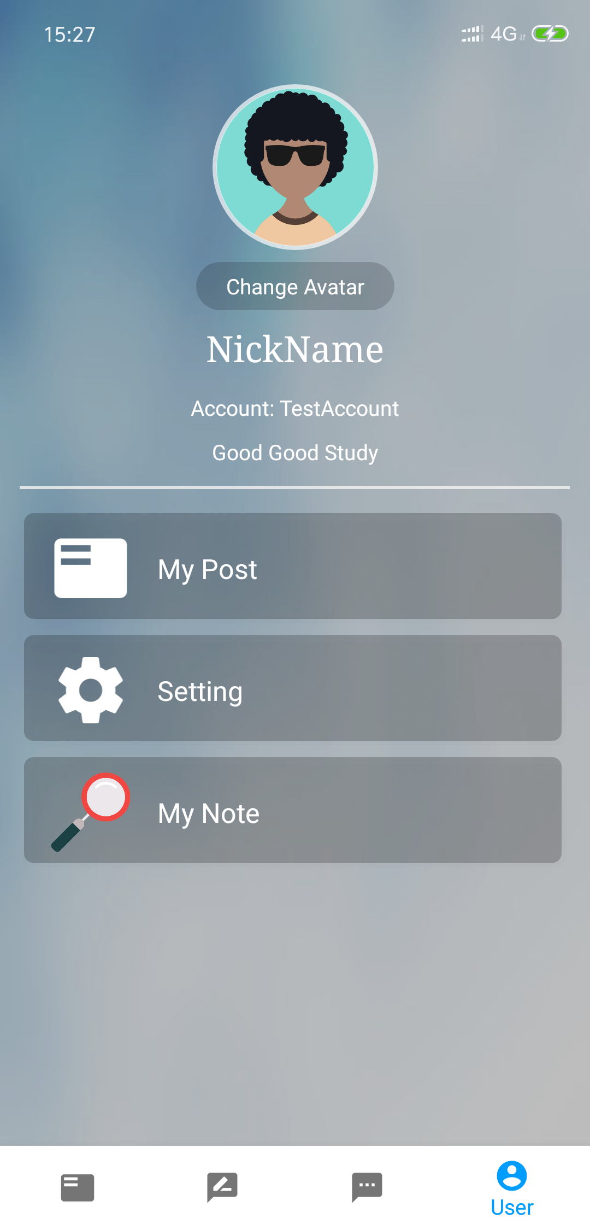
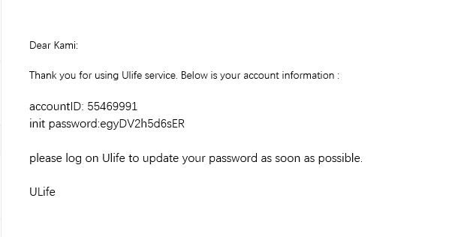
-->receive email
-->login
-->update password

Slide 20
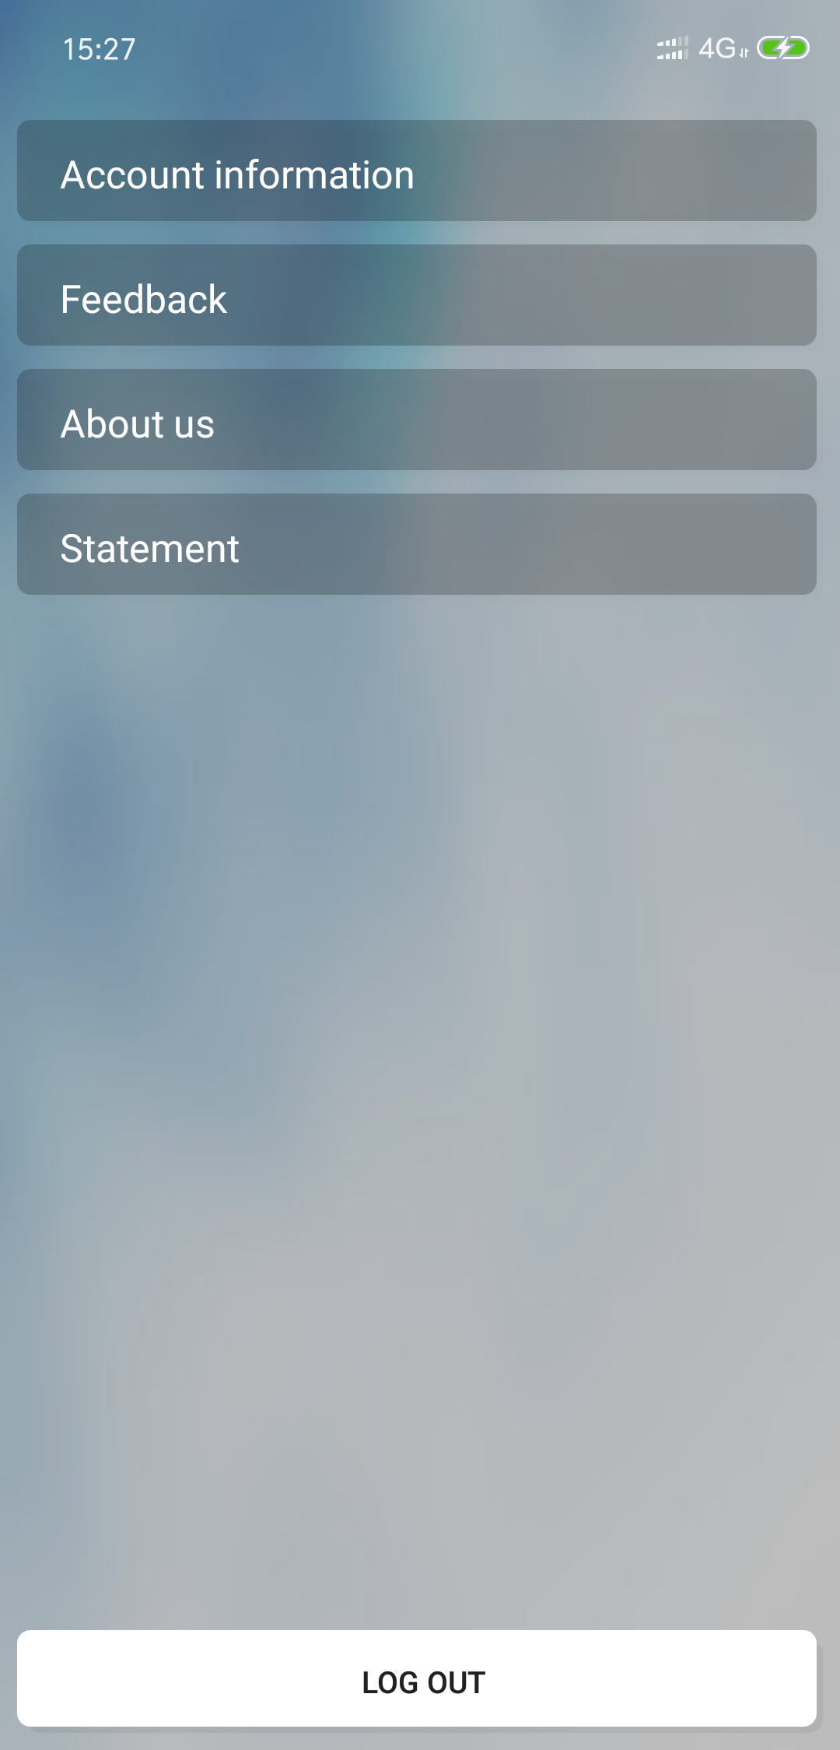
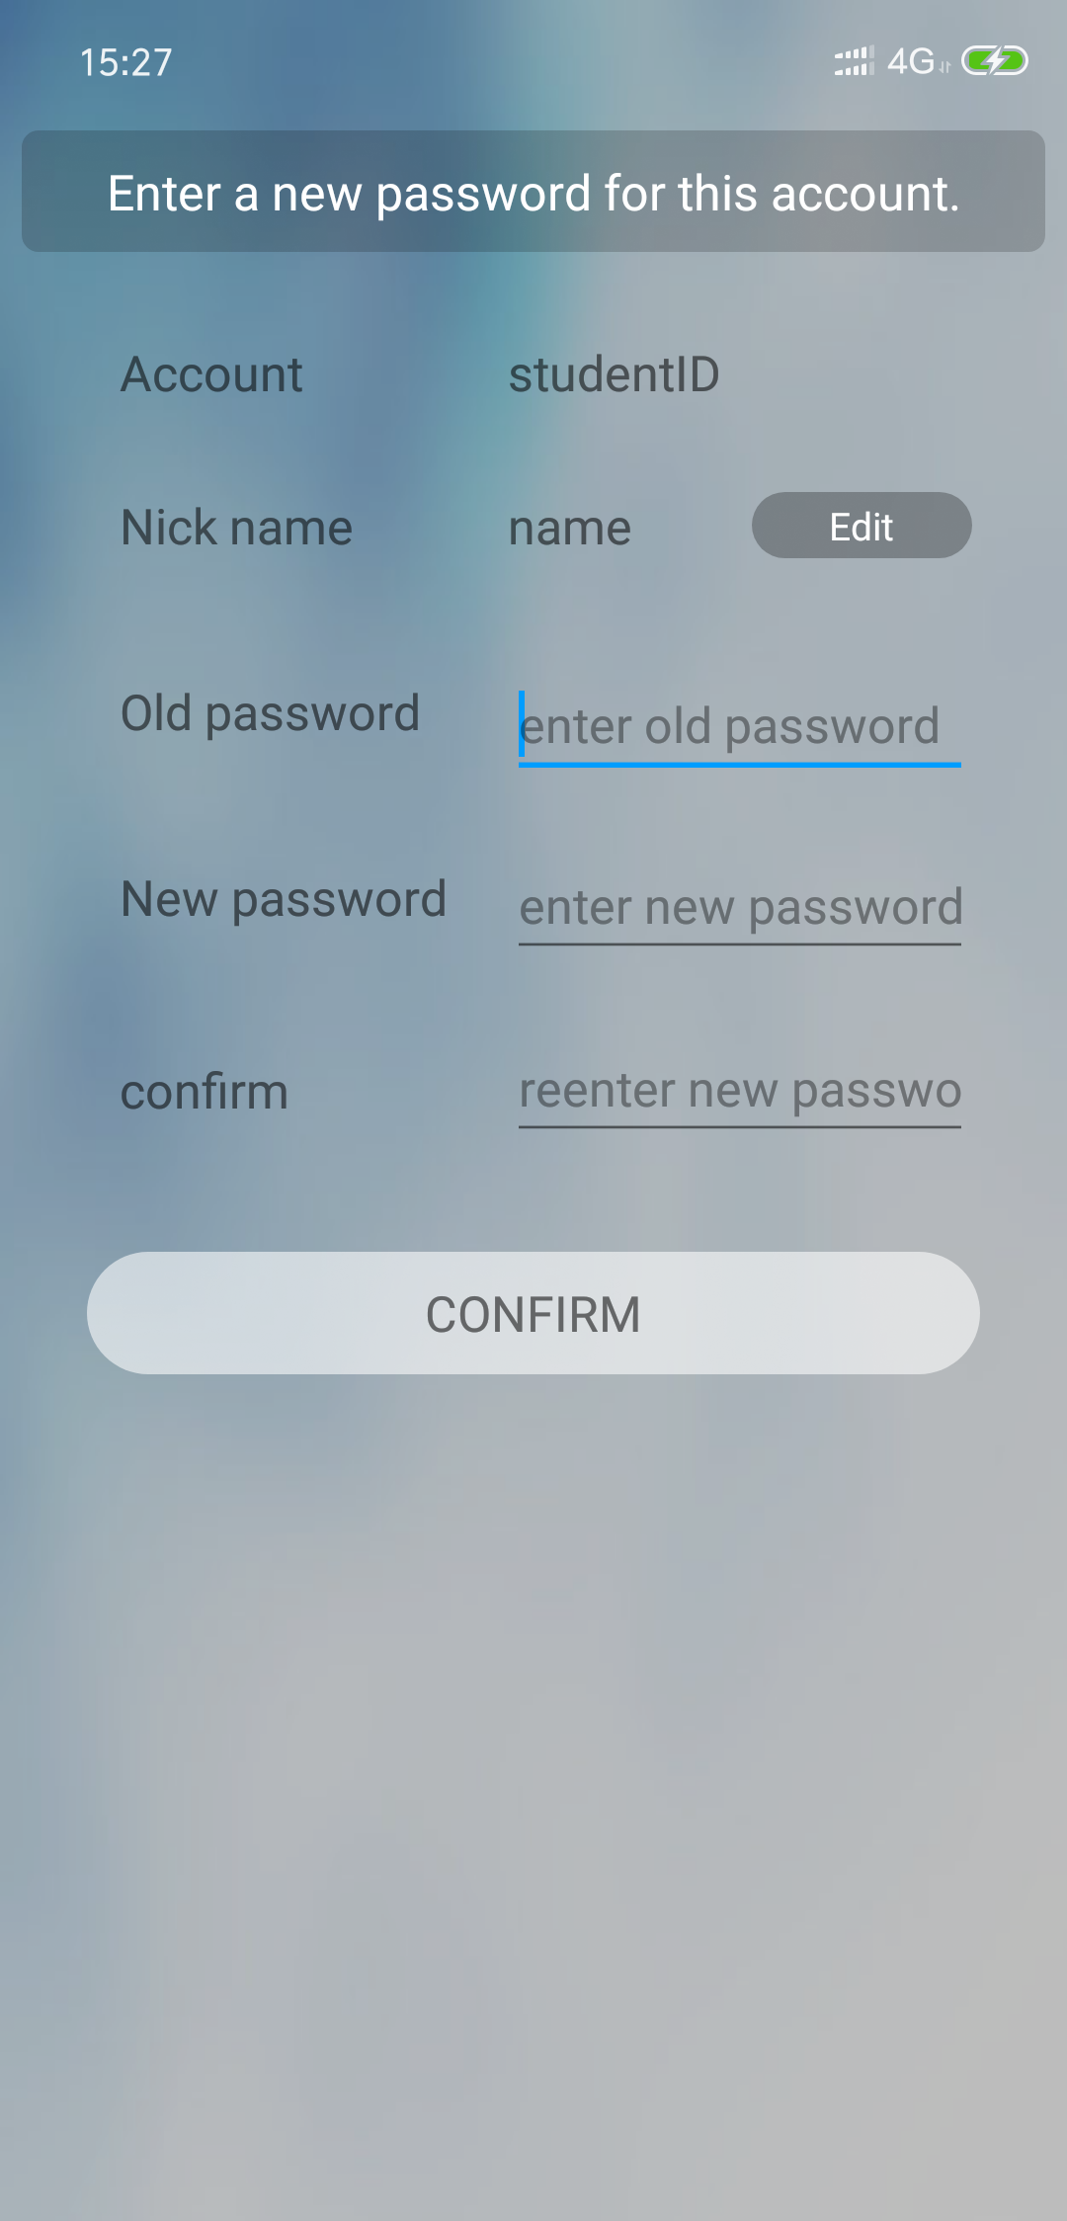
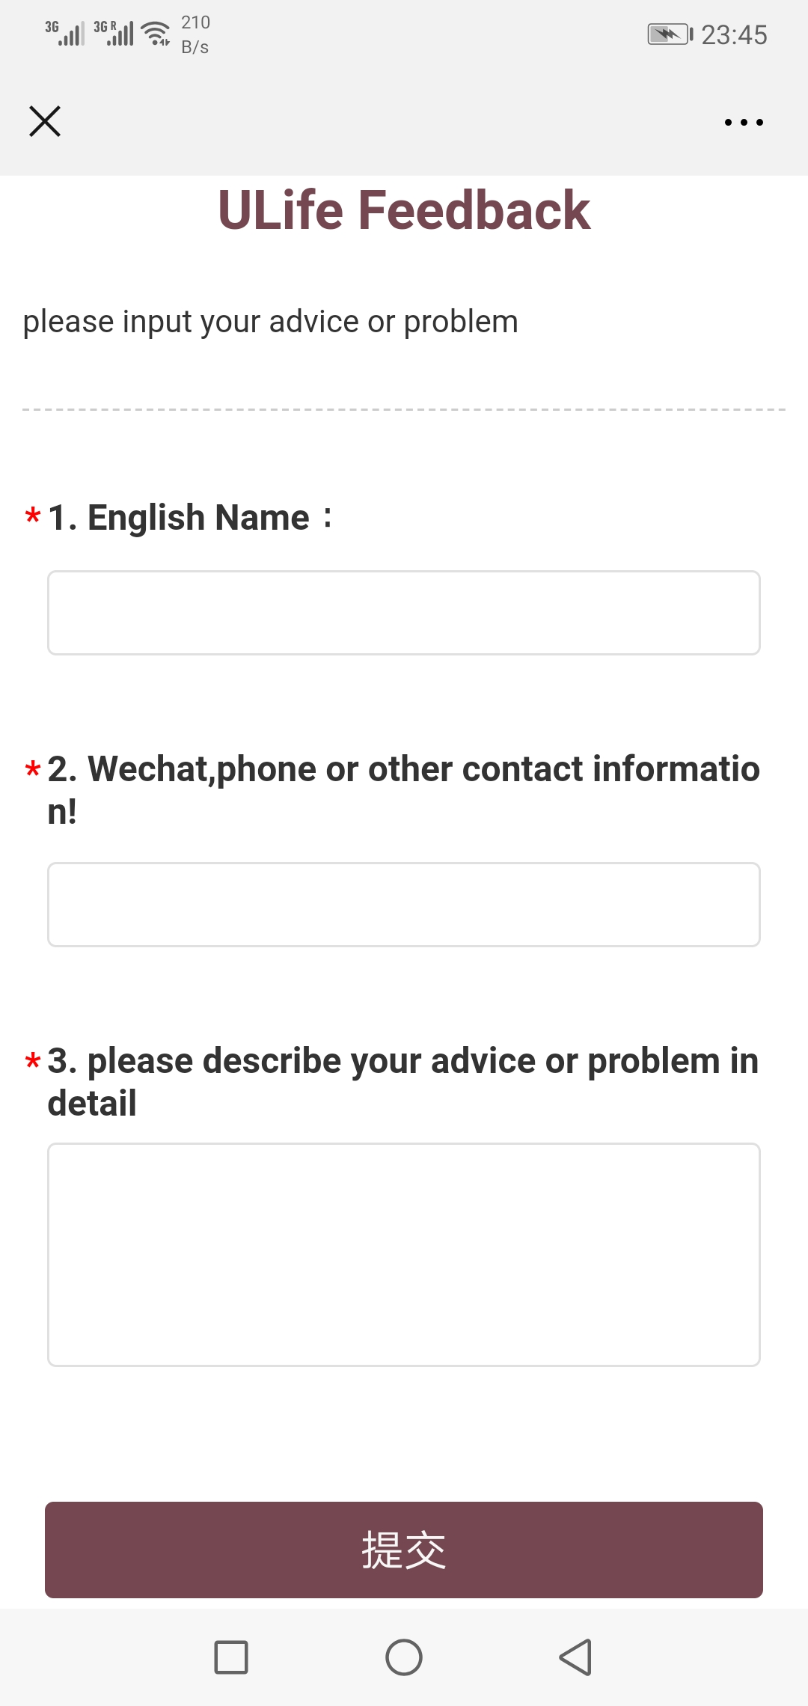
Get init passwords and update account information
Update account
information
If you have any
problem,
submit feedback

Slide 21
Part 2：Main Function
SUN Yuxi 55422550
XU Jiahe 55395280
Notes:
Good evening, everyone. My name is SUN Yuxi. And my partner XU Jiahe and I will introduce the main function of ULife.We will tell u a story to display the function vividly.

Slide 22
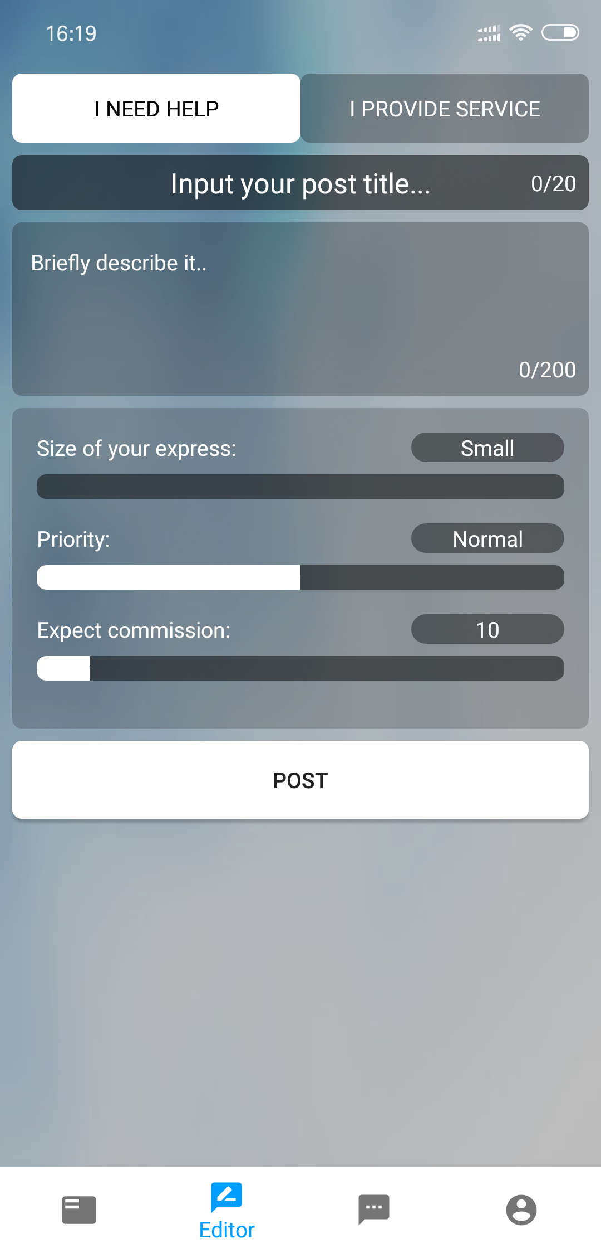
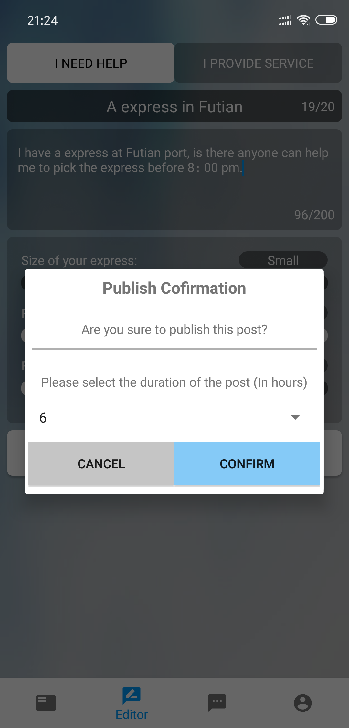
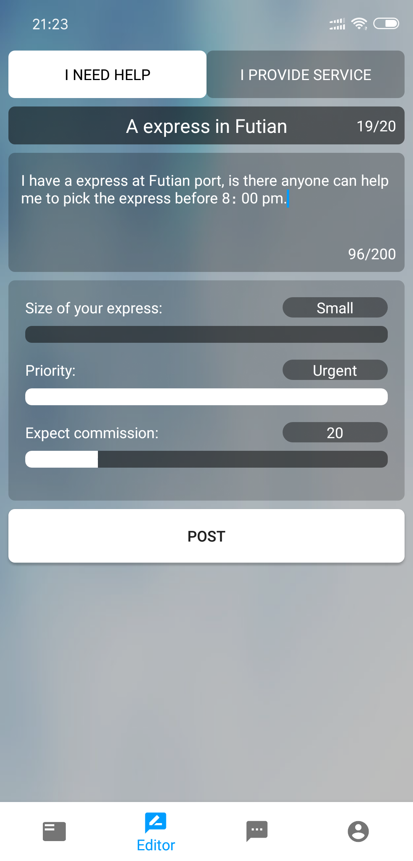
The page of editor
1
2
3
Notes:
In the story my name is Kami, today I have an express at Futian port, but I have no time to go there, and it will cost me a lot. So I would like to use ULife to post a meesage for help. Now let me edit my message, firstly choose the button of I NEED HELP, secondly, edit the title and description, thirdly, chose the main information of express, it is very convenient, because I can just drag the bar and there is no need to type. Finally when I click the post button, I am noticed to choose the valid duration.

Slide 23
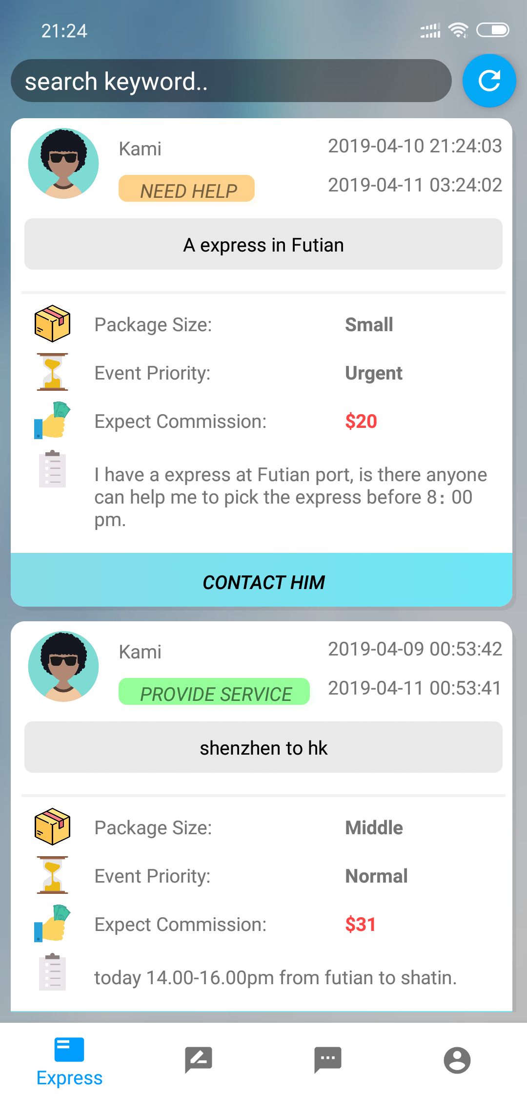
Posted message
1
It shows your valid time.
2
Main Information
Notes:
Now I post the message successfully. We can see the valid time and main information directly.

Slide 24

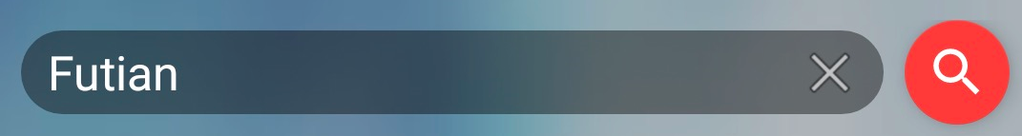
Browse messages
Notes:
XU1
Hello everyone, my name is XU Jiahe. But in our story, I am Joe.
Now I am in Shenzhen, and tonight, I will go back to Hong Kong through Futian Port.
The travelling fare is so expensive as 60 HKD. So I want to see if I can help anyone pick up an express to earn some money.
Let me open Ulife and browse the posted messages.
There are lots of messages, so I’d better input the keyword “Futian” and search.

Slide 25
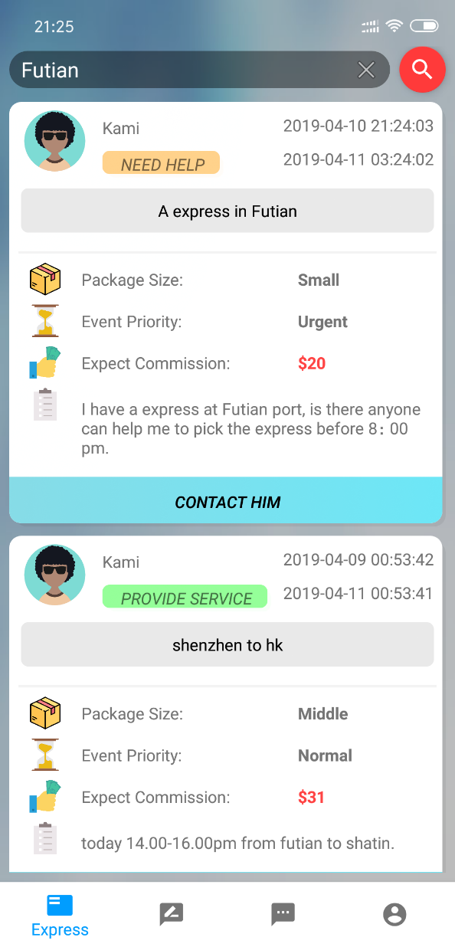

Keyword search
1
Today
2
Futian Port
20 HKD
Notes:
XU2
Now I can find a satisfactory message posted by Kami.
He hopes someone can pick up his express today.
At Futian Port.
And the commission is 20 HKD.
Let me connect him.

Slide 26
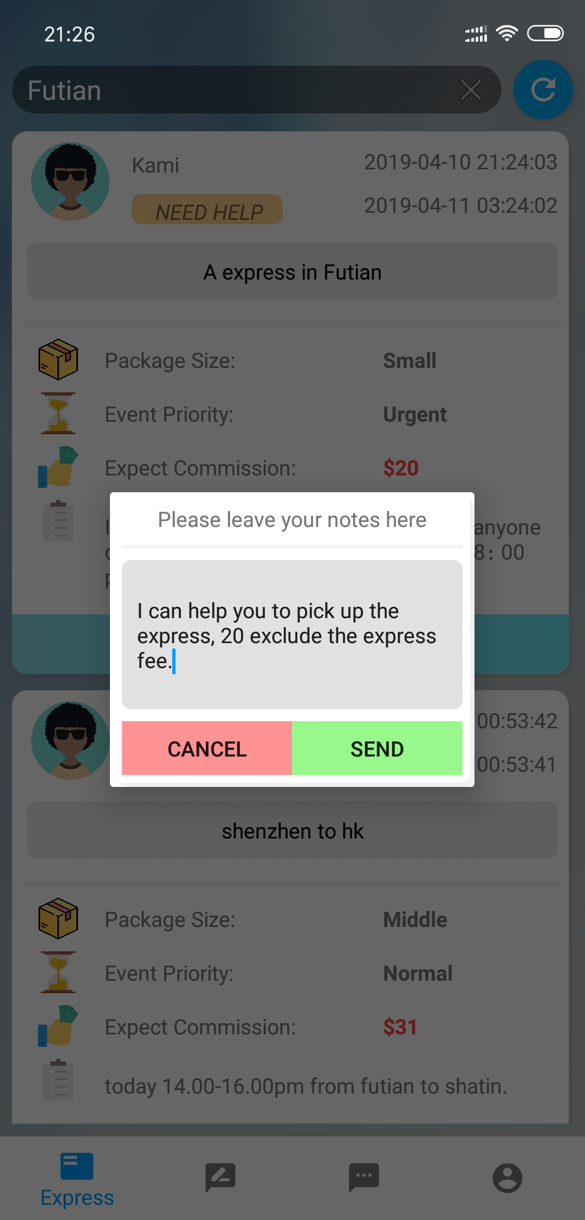
Chatting application
Hello, I can help you pick up the express.
Notes:
XU3
At first, I need to send him a chatting application.
Hello, I can help pick your express at Futian Port.
Now I can do something else and just wait for his reply.

Slide 27
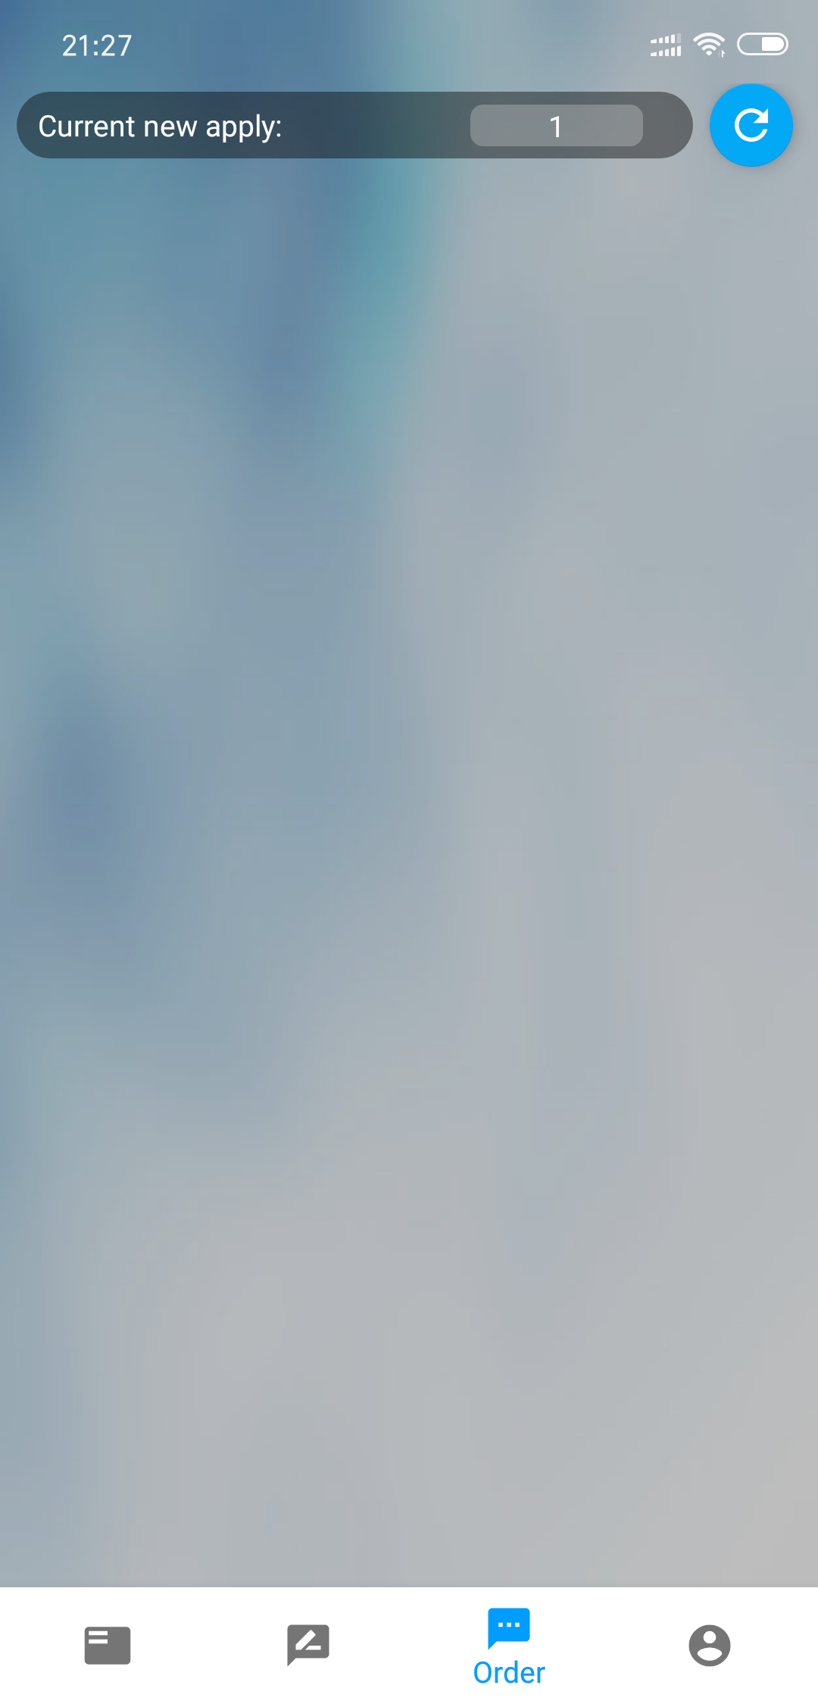
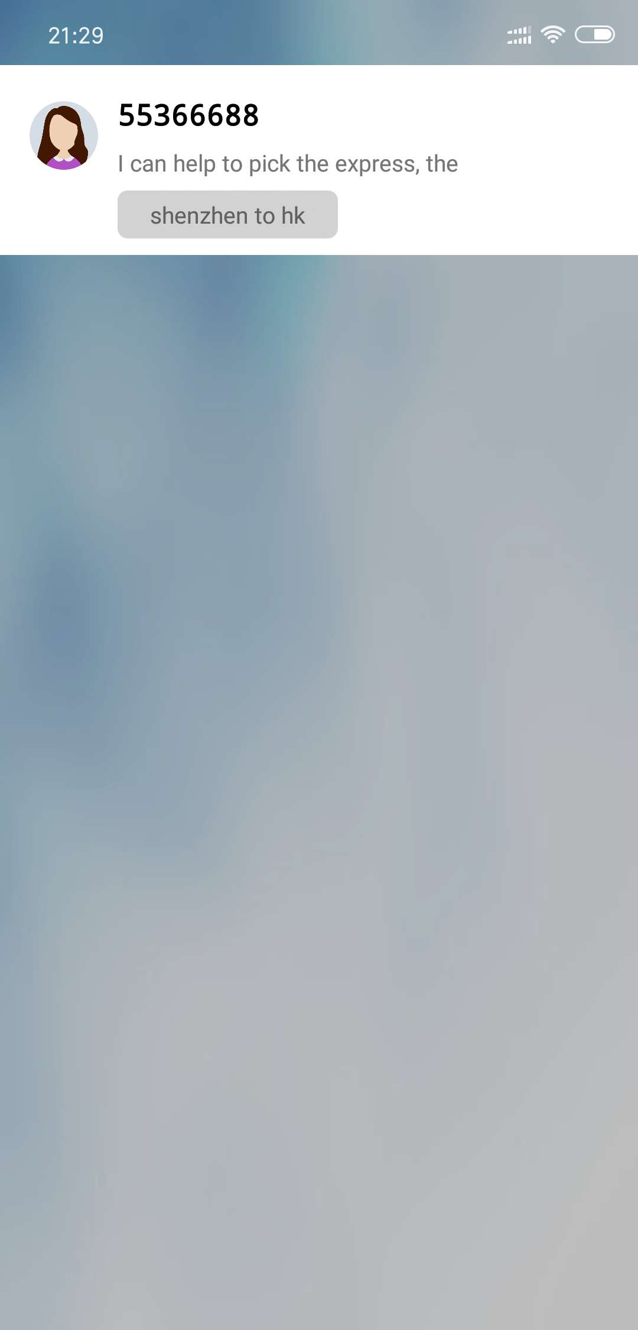
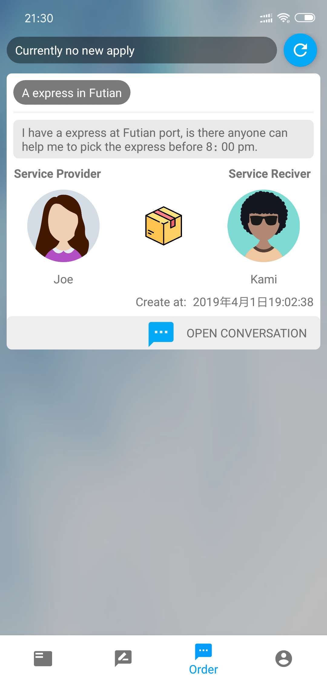
Notes:
Now I receives the chatting application, and let us verify it and start the chat.

Slide 28
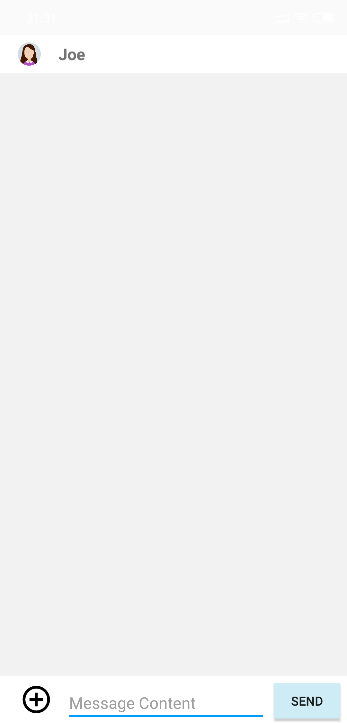
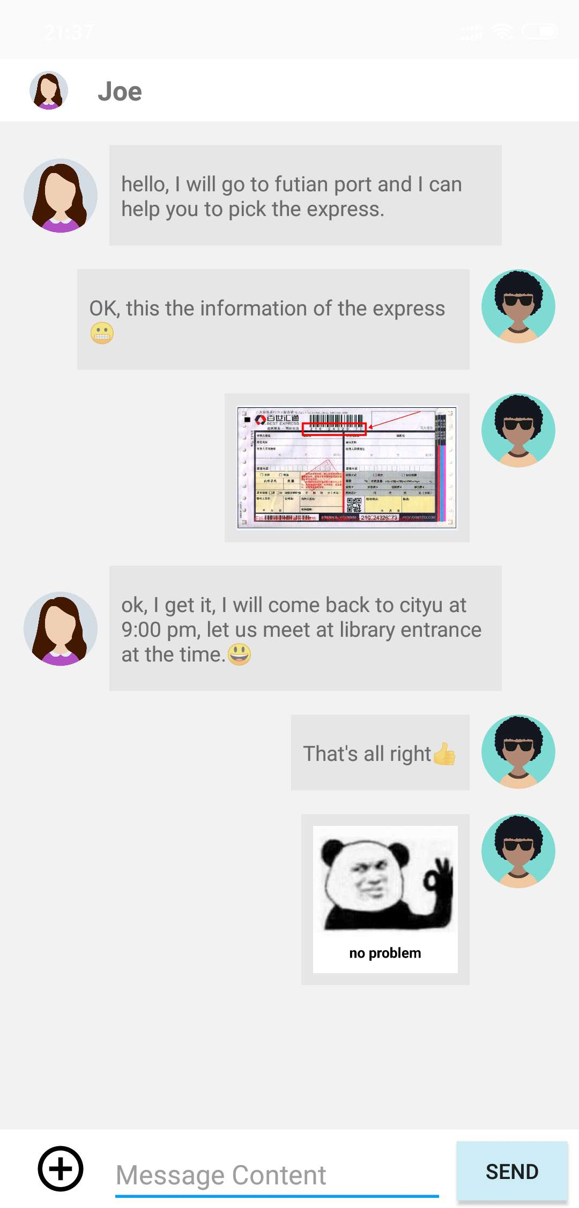
Chatting
Notes:
XU4 & SUN
Joe: Hello, I will go to Futian Port after a while and I can help you pick up the express.
Kami: OK, this is the information of the express.
Joe: OK, I got it. And I will come back to CityU at 9:00pm. Let us meet at the library entrance at that time.
Kami: That’s all right.

Slide 29
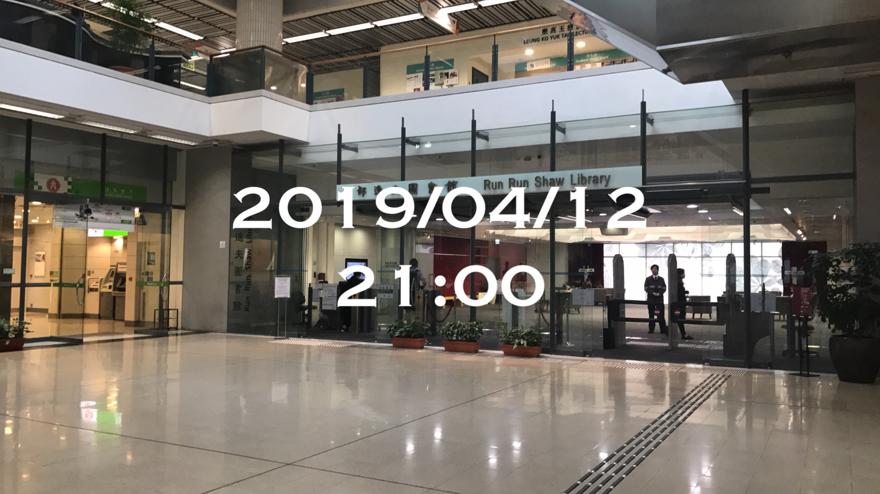
Notes:
XU5

Slide 30
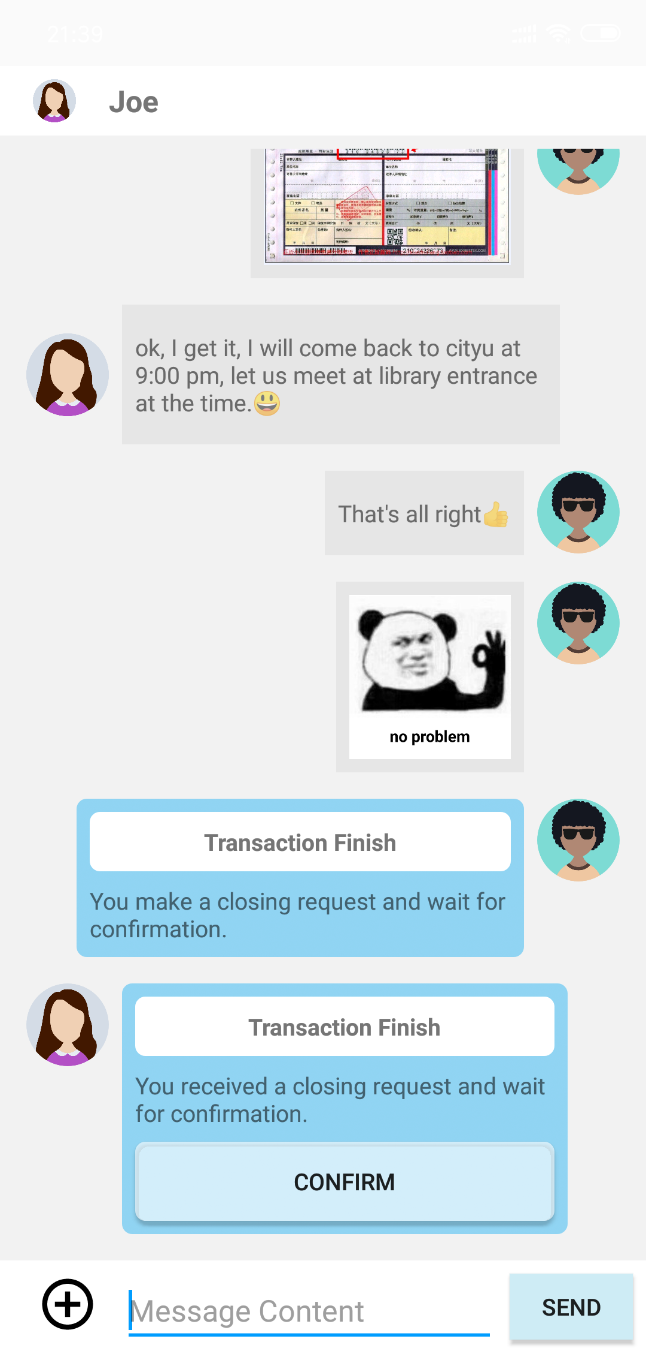

End the deal
Notes:
XU6 & SUN
I makes a closing request to confirm the end of the deal.
Joe receives the closing request and clicks the confirm button.
Then the chatting box will disappear. And they can not disturb each other any more.

Slide 31
4
Technical Issue
Zhou zixuan 55366688
Notes:
Hello everyone, now I’m going to talk about some technical issue

Slide 32
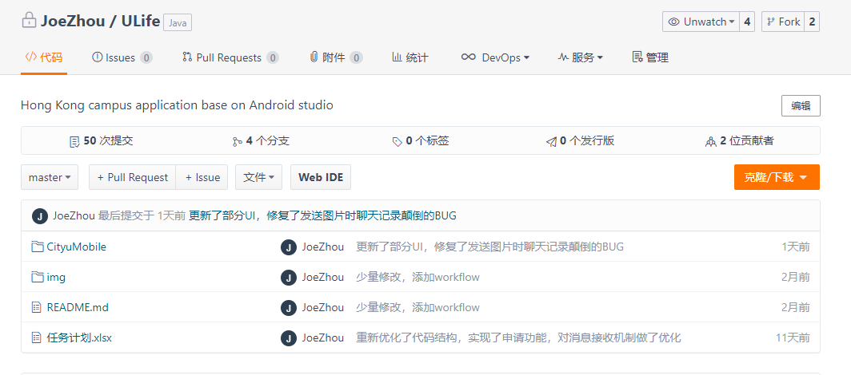
Software Architecture and Version Control
We use gitee to trace the whole developing process of our app.
As we use the incremental model to develop our app, the 4 prototype of our app in different stage is stored in 4 different branches.
Notes:
For the version control, we use git...

Slide 33
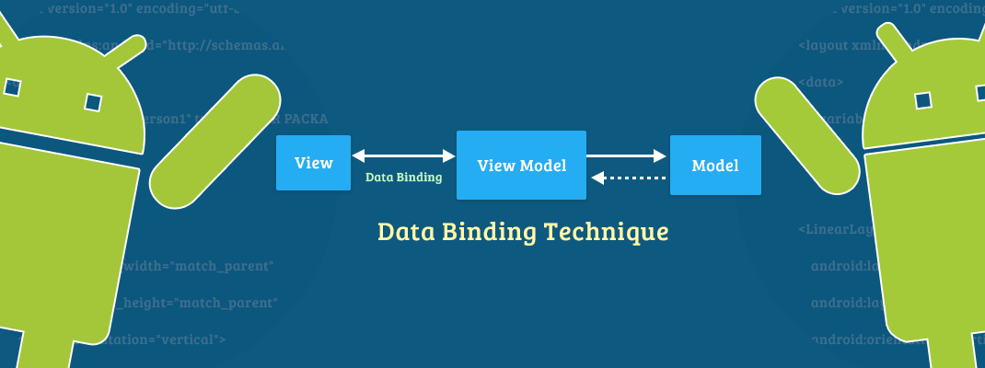
Software Architecture and Version Control
The development framework we use is the MVVM framework, with the help of the databind utils in android.
Thanks to the bidirectional data binding function of databinding utils, we have realized the automatic synchronization of View and ViewModel, also since our in-app communication framework is designed based on the observer pattern, all data changes will be automatically synchronized to the View layer.
Observer pattern

Slide 34


Advanced technology
We use a image compression algorithm which called Luban to compress our image.
3.69Mb 4K JPEG Image
Compression rate over 96%
136kb 2K JPEG Image
Notes:
As for the advanced technology we are using, the first is the Luban image compress algorithm, can you see the difference between these two images? the left one is a image shooted on Xiaomi8 and the resolution is 4K in jpeg formation and the size is 3.69MB if we store it in bmp format the size will become nearly over 30Mb, but the right one is the image that further compress using Luban algorithm, it’s only 136kb and with 2K resolution, over 96% compression rate and which can make the transportation of the chat image much more efficient.

Slide 35
Advanced technology
We also use multi-layer image caching technology called Universal Image Loader.
All of the image resources include post image and offline chat image even the user avatar is stored in different caching layer.
Layer 1 - Network caching
Layer 2 - Local caching
Layer 3 - Memory caching
For each image resource, we organize them with a unique tag and a hash code, by comparing the hash code of the local source with the network caching, it can determine whether we need to refresh the data from the server.

Slide 36
Advanced technology
For the communication part, normally we use the p2p communication between two users when they are chatting.
But if one side user is offline(offline more than 1 min, since the heart-beat rate of us is 1 packet/min) our app will change the communication mode using our server as a middleman, all the offline message will be record in our server and will be stored for 48 hours, since the longest valid date of our post is 48 hours.

Slide 37
Advanced technology
We also provide a chat log backup function which is implemented by using Google Zxing QRcode library and Gzip library to backup your data, after each transaction is done, we support you a function which can auto convert your chat log into a private QRcode, and later you can retrieve your data from it.
However, as we are very concerned about user privacy, this feature is still on testing and has not yet been installed.
Notes:
You may wonder that if I have some trouble on the transaction, can I save some evidence like chat history? Yes, of course.

Slide 38
5
Conclusion
Notes:
Finally, let me make some conclusion

Slide 39
Key Principle of Design - 20/80 Rule
80% of person you only contact with them at 20% of time.
e.g. Order based conversation.
80% of things can be explained using 20% of words.
e.g. Our post editor, you only need to type some sufficient information,other information will be auto generated.
80% of person 80% of time will not keeps looking at their mobile phone.
e.g. Offline message system can help you avoid message losing.
You can use 20% of time to get 80% of information.
You can use our app to earn or save 80% of transportation fee.
...
Notes:
The key design principle of our app is based on 20/80 rules

Slide 40
About future
Our app has one version of prototype is partially written by using Google flutter framework, we'll probably continue to work on this and make this app cross-platform for both android and IOS.
We plan to provide more interactive areas such as studying BBS after optimizing the delivery function.

Slide 41
End
Thank you
Notes:
That’s all of our presentation, ulife, hope to make your university life much easier.

